Slide 1
AI Conference and RL
赵思博

Slide 2
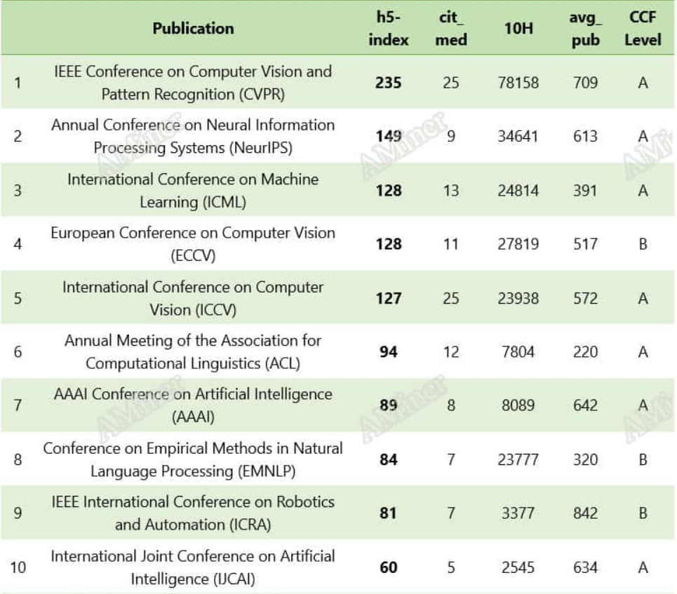
Aminer rankings
统计deadline：2019
https://www.am.ai/en/blog/ai-conferences-2023/
值得收藏！2024年人工智能顶级会议投稿信息汇总（机器学习领域）_nips2024-CSDN博客

Slide 3
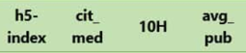
评价标准
1. H5-index ：Analogy to Impact Factor
2. Citation medium : 引用中位数
3. The sum of the citations of the 10 most cited papers
4. Average publication

Slide 4
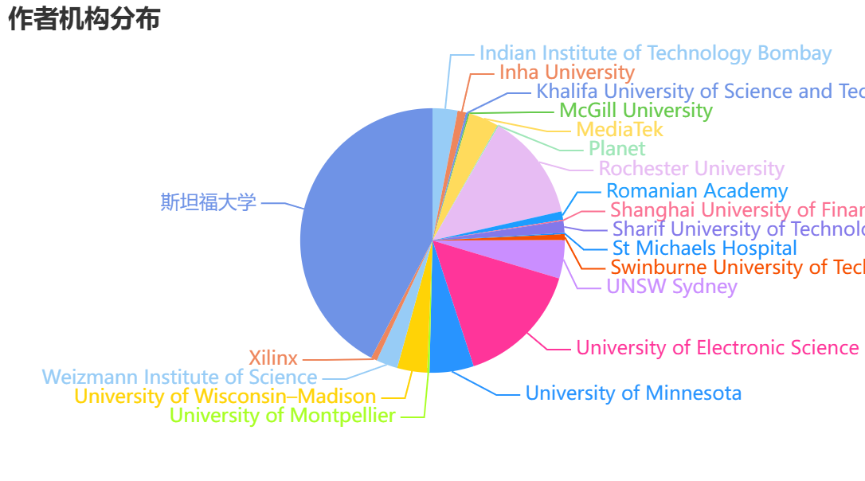
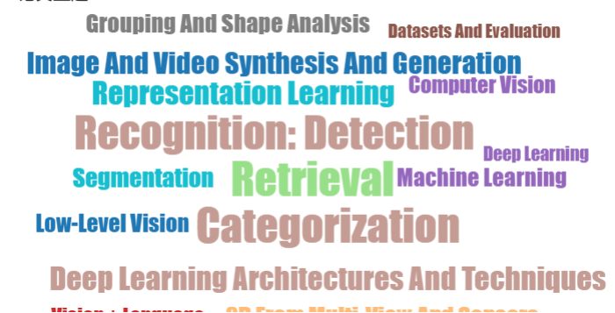
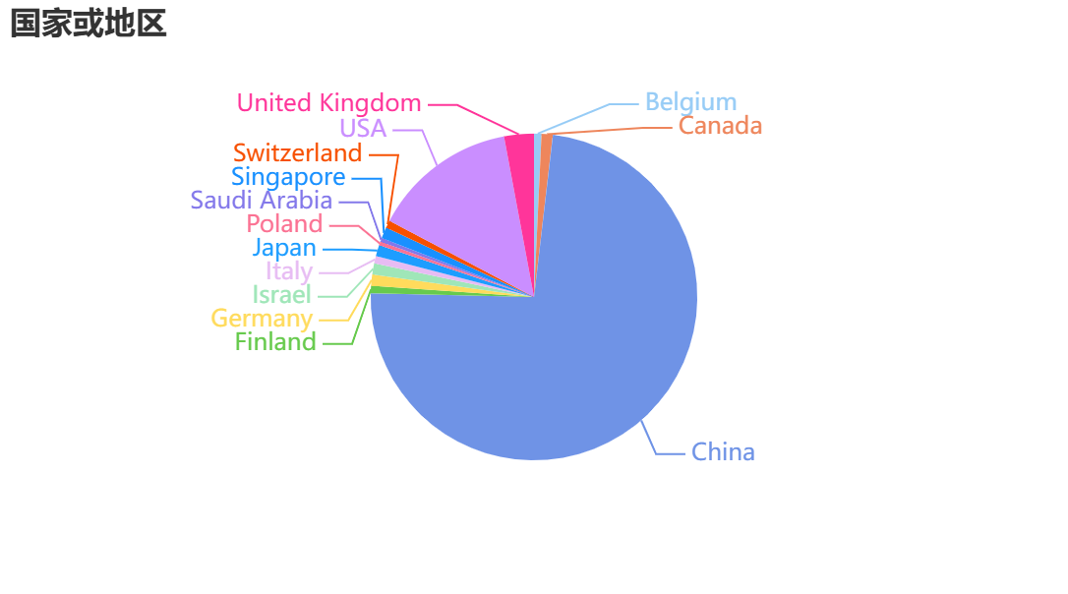
Conference on Computer Vision and Pattern Recognition

Slide 5
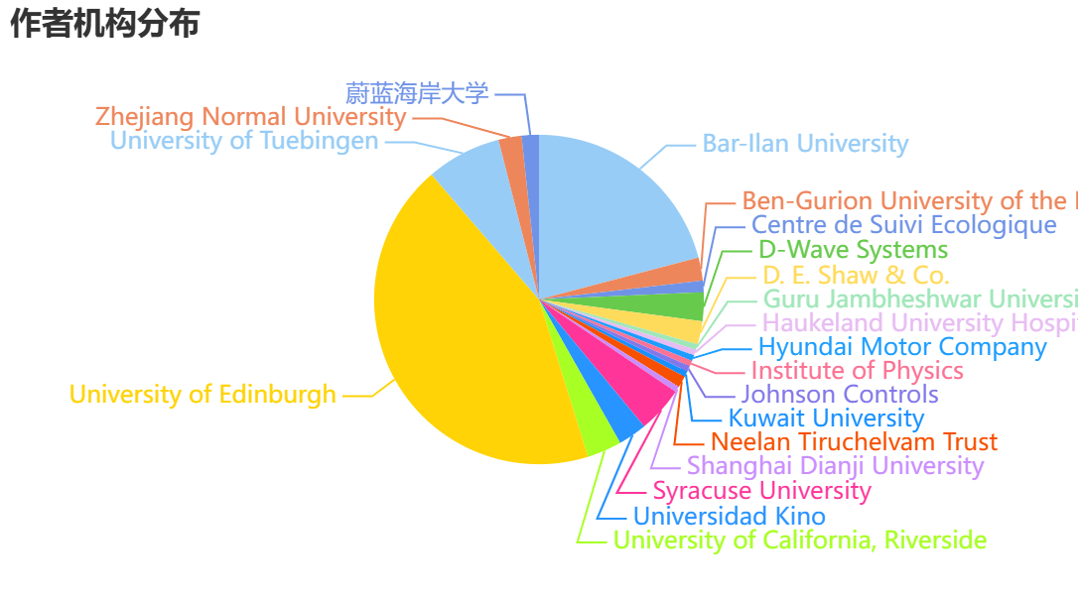
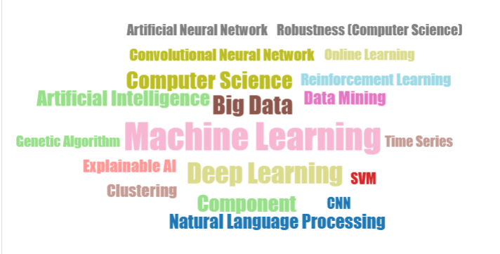
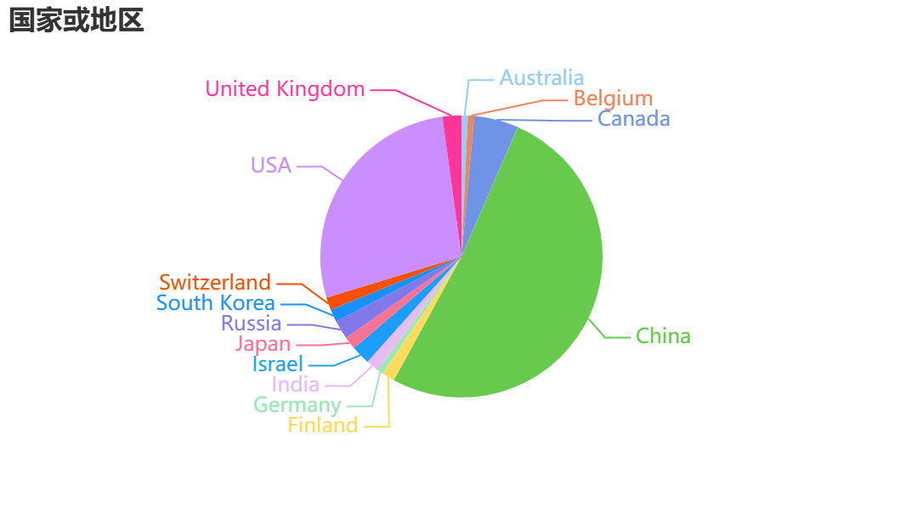
International Machine Learning Conference

Slide 6
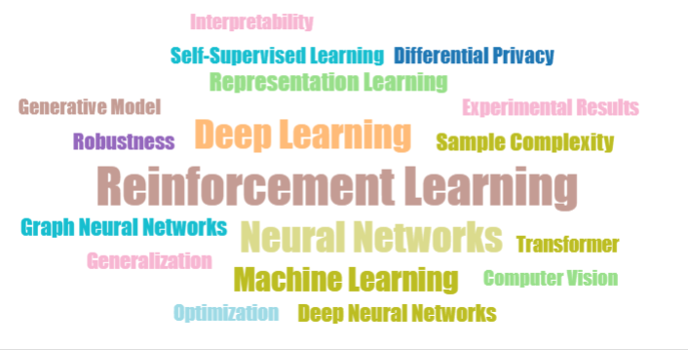
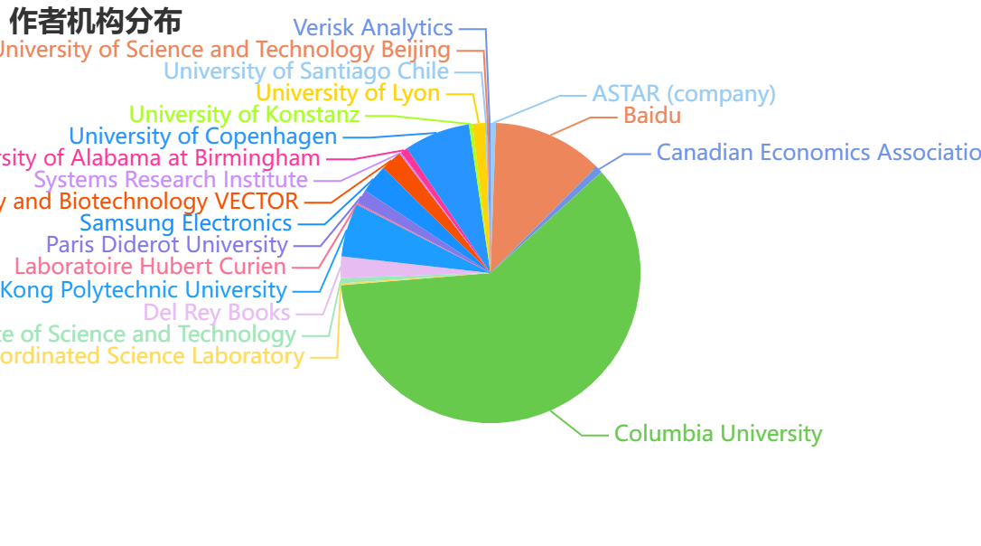
Annual Meeting of Neural Information Processing Systems

Slide 7
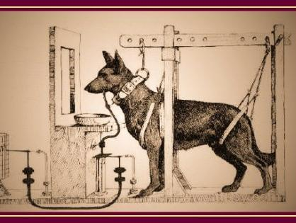
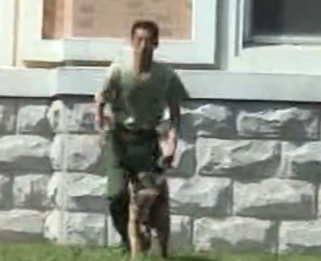
Origin of RL : Behavioral Psychology
Relation between AI and other subjects
奖励与惩罚：有机体在特定环境，通过特定学习策略，实现回报最大化的问题

Slide 8
Core Issue：Quantify
我们面向的对象是machine，关键在于如何衡量
无法回避的问题：
怎么衡量当前的状态
怎么量化机器的奖励
怎么给他设定一个方法使其在环境中学习
……

Slide 9
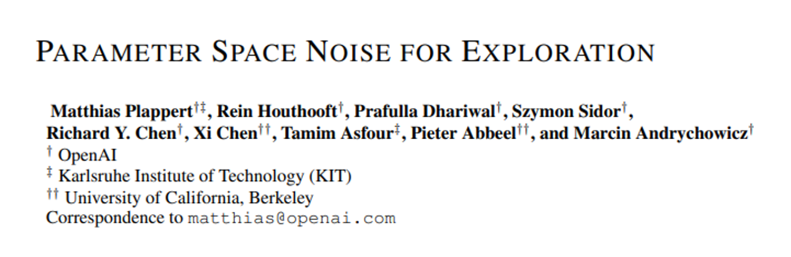

We consider the standard RL framework consisting of an agent interacting with an environment. To simplify the exposition, we assume that the environment is fully observable. An environment is modeled as a Markov decision process (MDP) and is defined by a set of states S, a set of actions A, a distribution over initial states p(s0), a reward function r.

Slide 10
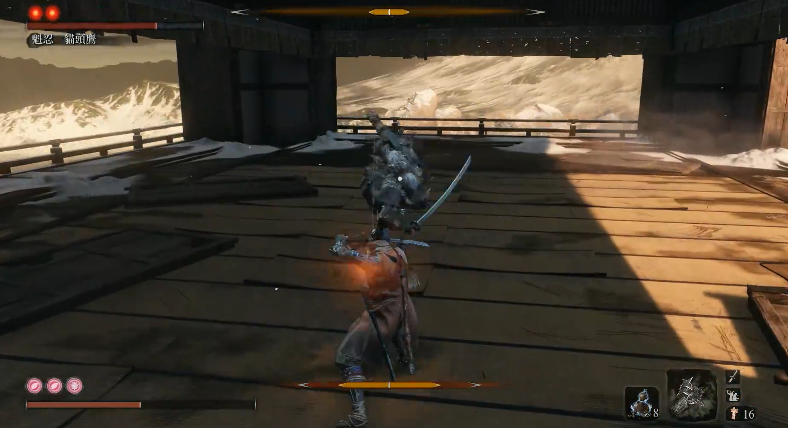
Actual Case: Sekiro
Agent: Sekiro
Environ: 天守阁
State：自己血量（包括
药的数量）
Reward：对手血量

Slide 11
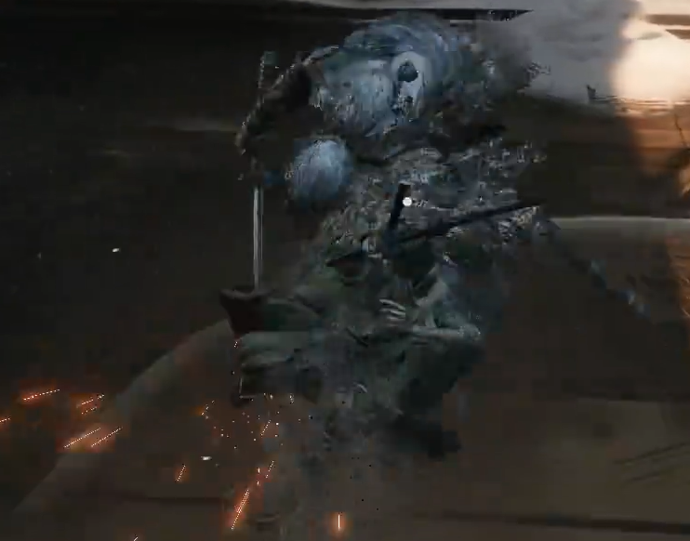
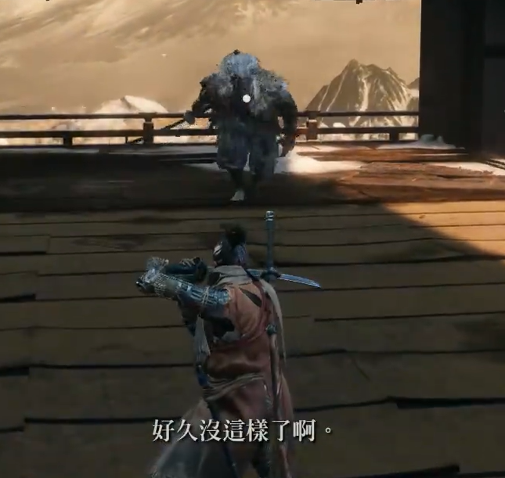
Actual Case: Sekiro con‘d
Action： 攻击和防守

Slide 12
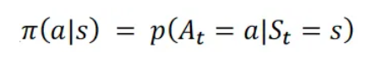
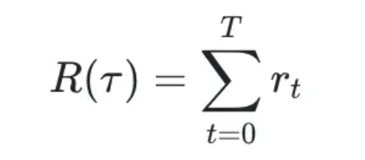
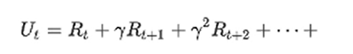
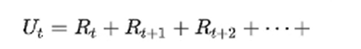
The thing is：怎么动态的求解
Mathematics and two concepts
Policy (Strategy)
动作a的概率（随机性策略）：
当下情况：<s, a, r>
Value（Reward）
（discounted parameter 是人为设置）

Slide 13
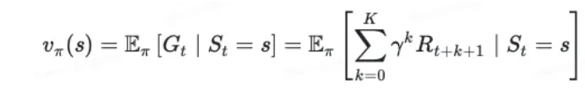
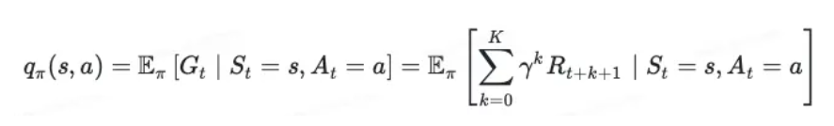
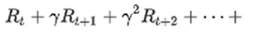
状态价值函数与状态动作价值函数

Slide 14
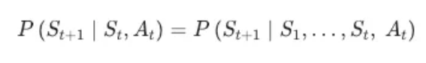
马尔可夫决策过程
强化学习是一种优化训练方式，优化数学方法，优化数据集最大化reward，最终提升学习效果的学习过程(重复与环境互动)
只狼RL可行性：动作数量少，状态少且简单，可以收敛，Reward分配可行

Slide 15

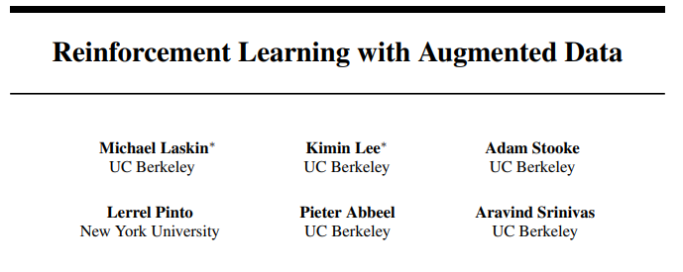

Slide 16
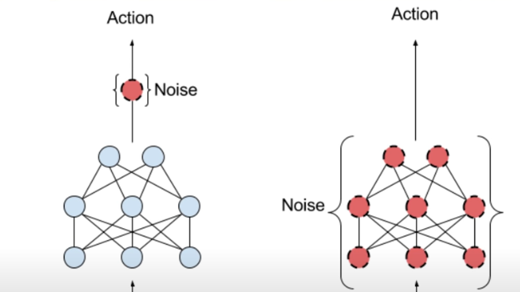
Parameter Space Noise
Exploitation
Exploration

Slide 17
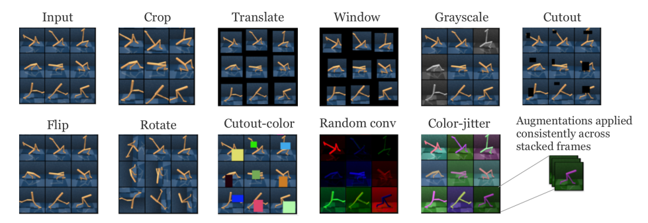
RL with augmented data
What is data augmentation? Normal in supervised task
https://arxiv.org/pdf/2004.14990

Slide 18
What matters
Learning from visual observations is a fundamental problem in reinforcement learning.
RL is notoriously plagued with poor data-efficiency and generalization capabilities.
One such often ignored prior is Data Augmentation.
(All cited from the original page)
关注到了Reinforcement Learning非常重要的方向， visual observations， 以及泛化上的能力不足，
提出的解决方案是一个一举多得的方案，如果有效

Slide 19
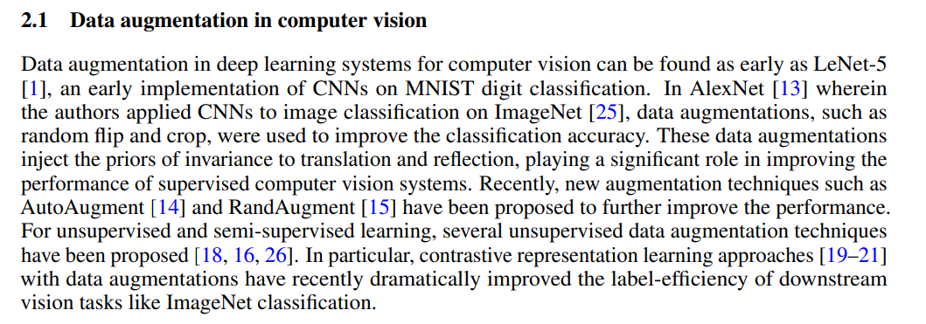
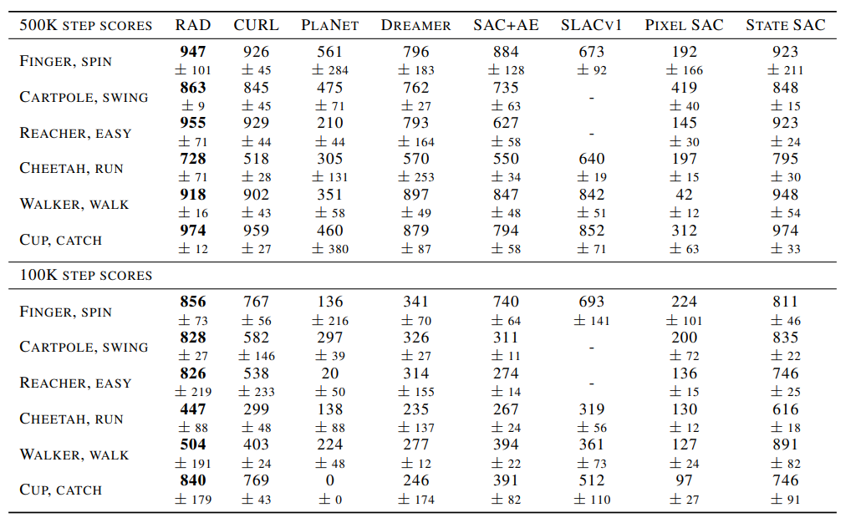
Related Work

Slide 20
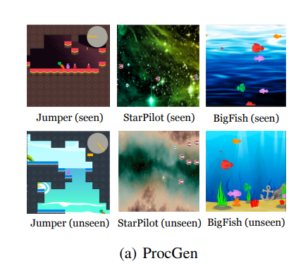
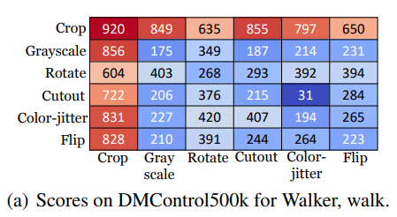
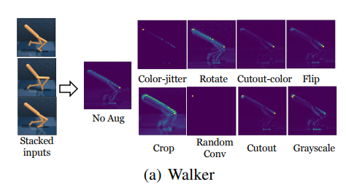
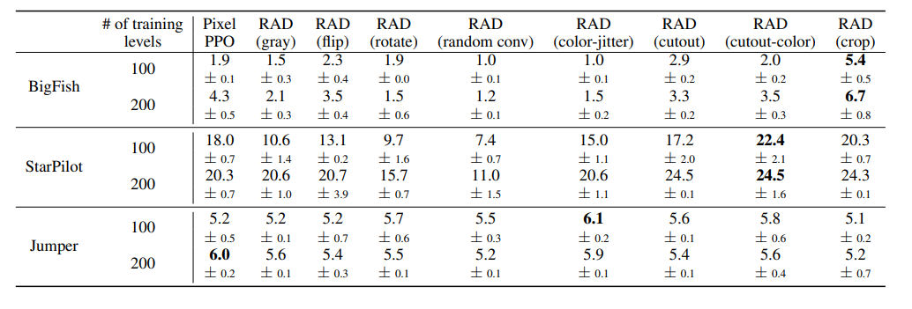
Case Comparison

